Slide 1
Managing strategy and strategic planning
Chapter 6
Miami Dade College
Sep 21st,2019

Slide 2
Strategic management
Strategy: a comprehensive plan for accomplishing the goals
SM: a way of approaching business opportunities and challenges
Formulating and implementing effective strategies
Effective strategies: A strategy that promotes a superior alignment between the organization and its environment and the achievement of strategic goals

Slide 3
Continued…
Distinctive competence: an organizational strength possessed by only a small number of competing firms
Scope: the range of markets in which an organization competes
Resource deployment: how an organization distributes its resources across the areas in which it competes

Slide 4
Types of strategic alternatives
Two levels:
Business level strategy:
Set of strategic alternatives an organizations chooses as it conducts business in a particular industry or market
Helps the organization focus its competitive efforts for each industry
Corporate level strategy:
Set of strategic alternatives an organization chooses as it manages its operation simultaneously across several industries
Overall strategy that helps define the mix of industries that are of interest to the firm

Slide 5
Strategy formulation and implementation
Formulation: set of processes involved in creating the strategies of the organization
- What the strategy is
Implementation: the methods by which strategies are operationalized within the organization
- How the strategy is achieved
Deliberate strategy: if the processes of formulating and implementing strategies are rational and planned
Emergent strategy: A set of certain consistent actions that form an unintended pattern that was not initially anticipated or intended in the initial planning phase
- The work of entrepreneurial engineers

Slide 6
SWOT analysis to formulate strategy
Exploiting an organization’s opportunities and strength
Neutralizing its threats
Avoiding or correcting its weaknesses
Evaluating an organization’s strengths:
Skills and capabilities that enable an organization to project and implement its strategies
Managerial talents, unique reputation, brand name, distribution channels, trained employees

Slide 7
Types of strength
Common strength: an organizational capability possessed by a large number of competitive firms
Distinctive competencies: strength possessed by only a small number of competing firms
DC CA Above-normal economic performance
The main purpose of SWOT analysis is to discover an organizations’ DCs and exploit them in strategies

Slide 8
Imitation
Imitation of DC: other organizations are trying to duplicate these advantages
Strategic imitation: the practice of duplicating another firm’s DC
Sustained CA: strategies that exploit some DC which are inimitable
For instance: the nature of some DC is not known Or it is based on organizational teamwork or culture

Slide 9
Weakness
Organizational weaknesses: capabilities that don’t enable an organizations to choose strategies that support its mission
Two ways of addressing weaknesses:
Making investments to obtain the required strength
Modifying the mission based on the existing capabilities and skills
Competitive disadvantage: not implementing the valuable strategies being implemented by competitors
Competitive disadvantage below-average levels of performance

Slide 10
Opportunities and threats
Analyzing an organization’s environment
Opportunities: areas that may generate higher performance
Threats: areas that increase the difficulty of an organization’s achieving high performance
Porters’ five forces model characterizes the extent of opportunities and threats in an organization’s environment
If the levels of 5 forces are high: few opportunities in the industry and the economic performance will be normal
If the levels of 5 forces are low: numerous opportunities in the industry and the performance will be above normal

Slide 11
Business level strategies
Porter’s generic strategies:
1.1 Differentiation strategy:
An organization distinguish itself from competitors through the quality of its products and services (outstanding customer service)
Organizations charge more because of extra value (i.e.: Rolex, Lexus)
1.2 Overall cost leadership strategy:
Gaining a CA by reducing its costs below the costs of competing firms
By keeping costs low products are sold at low prices Profit

Slide 12
Continued…
1.3 Focus strategy:
Concentrating on a specific regional market, product line or group of buyers
Differentiating products in the focus market and selected regions (i.e.: Alfa Romeo)
Selling products at low cost in the focus market

Slide 13
Continued…
2. The Miles and Snow typology:
2.1 Prospector: highly innovative and risk-taking firms
Constantly seeking for new products, new markets (Amazon.com)
2.2 Analyzer strategy: Maintaining the current business and current customer satisfaction
Moderate emphasis on innovation (Yahoo!)

Slide 14
Continued…
2.3 Defender strategy: concentering on protecting the current markets
Maintaining stable growth and serving current customers
Lowering the costs and improving the performance of the existing products
2.4 Reactor strategy: no consistent strategic approach
- Reacting to environmental events

Slide 15
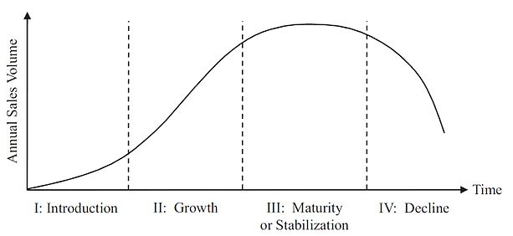
Continued…
3. Strategies based on the product life cycle:
How sales volume changes over the life of products
Strategies need to evolve over time
Introduction stage: demand outpaces the supply
Supplying products without sacrificing quality
Growth stage: sales continue to grow
Ensuring quality and delivery and differentiating products
Maturity stage: demand growth begins to slow down
Keeping costs low and beginning the search for new products
Decline stage: total sales drop and demand declines
- Keeping the costs low and developing new products

Slide 16
Corporate level strategies
Most large organizations are engaged in several businesses and industries
Decisions about which businesses and markets an organization will enter and how to manage these different businesses
Diversification: describes the number of different businesses that an organization is engaged in
Three types of diversification:
Single-product strategy:
An organization manufactures just one product or service
Concentrating on one product and single geographic market

Slide 17
Continued…
2. Related diversification:
Operating in several businesses, industries and the businesses are somehow linked
It reduces dependence on one business activities
It reduces the overhead costs
Exploiting strengths and capabilities in more than one business
i.e.: Disney and Universal
3. Unrelated diversification:
Operating multiple businesses that are not logically associated with one another
Corporate-level managers usually do not know enough about the unrelated businesses to provide strategic guidance
They usually fail to exploit important synergies

Slide 18
Example of unrelated diversification
GE:
Power and water
Aviation
Healthcare
Transportation
Oil and gas
Energy management
Appliances and lighting
GE capital: financial services

Slide 19
Becoming a diversified firm
1. Development of new products:
New products/services within the boundaries of the traditional business
2. Replacement of suppliers and customers:
Backward vertical integration: a company provides to begin its own supplies
Forward vertical integration: selling to the customer’s of customers
3. Mergers and acquisitions:
- Mergers: two organizations being combined are the same size
- Acquisition: one of the organizations is larger than the other

Slide 20
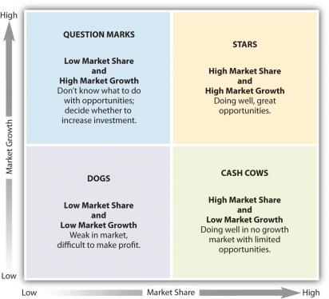
Managing diversification
Two major management techniques:
1. Organization structure
2. Portfolio management techniques: which business to engage in and how to manage these businesses to maximize corporate performance
- BCG matrix:

Slide 21
Continued…
Two factors to evaluate an organization’s businesses
Dogs: organizations should not invest in them Or sell them ASAP
Cash cows: generates high profits to support other businesses (question marks and stars)
Question marks: the future performance of these businesses is uncertain, it needs to invest carefully
Stars: businesses that have the largest share of a rapidly growing market
The most attractive businesses
Cash generated by cash cows should be invested in stars

Slide 22
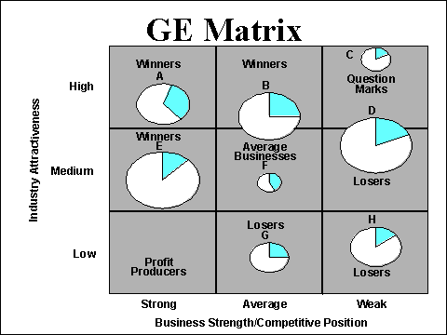
GE business screen
Organization should invest in winners and in question marks
Organizations should maintain the market position of average businesses and profit producers
Organizations should sell losers

